Slide 1


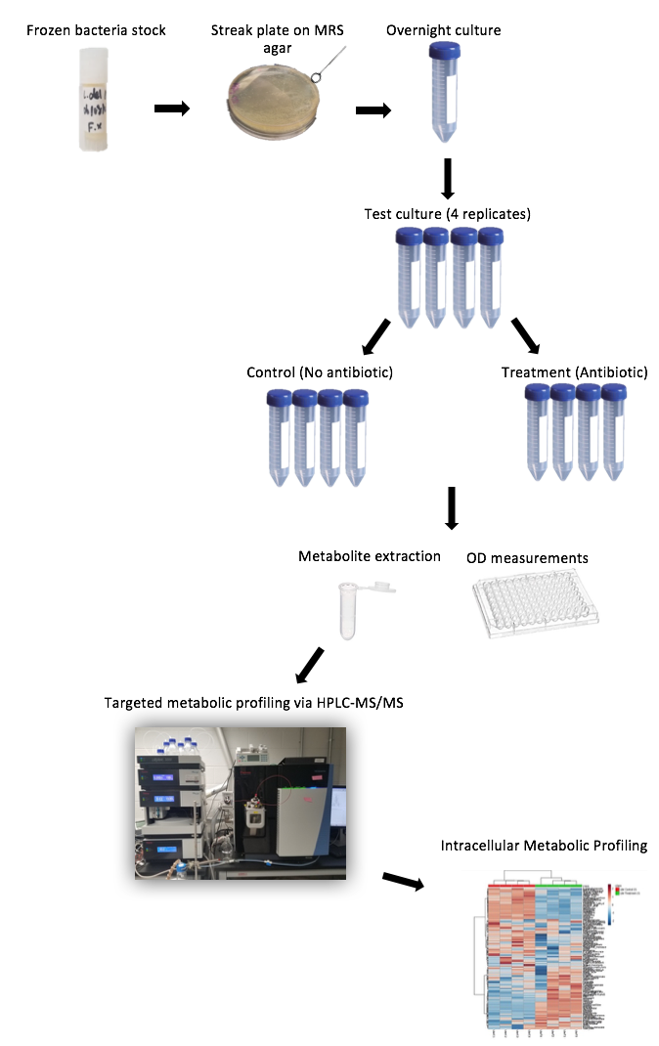
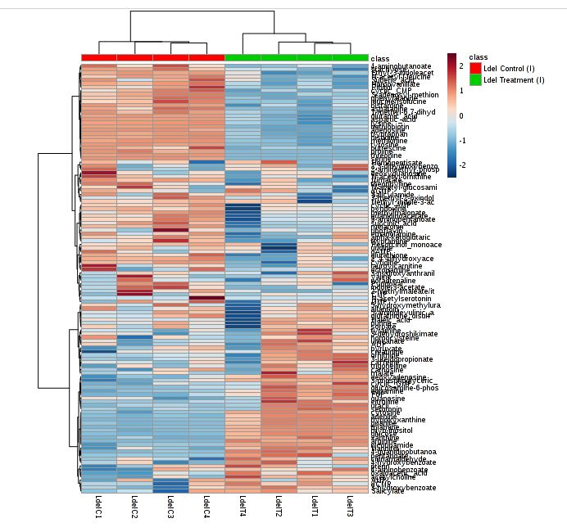
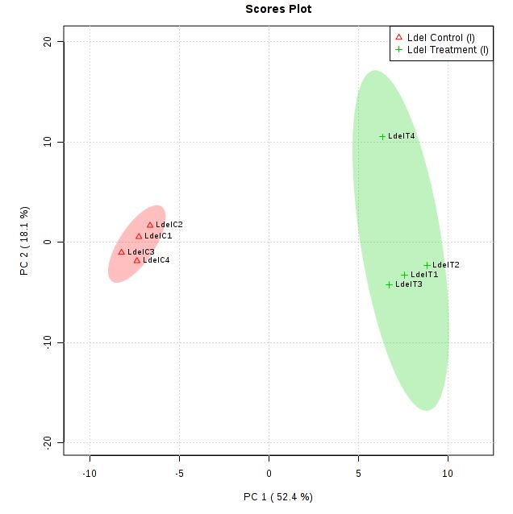
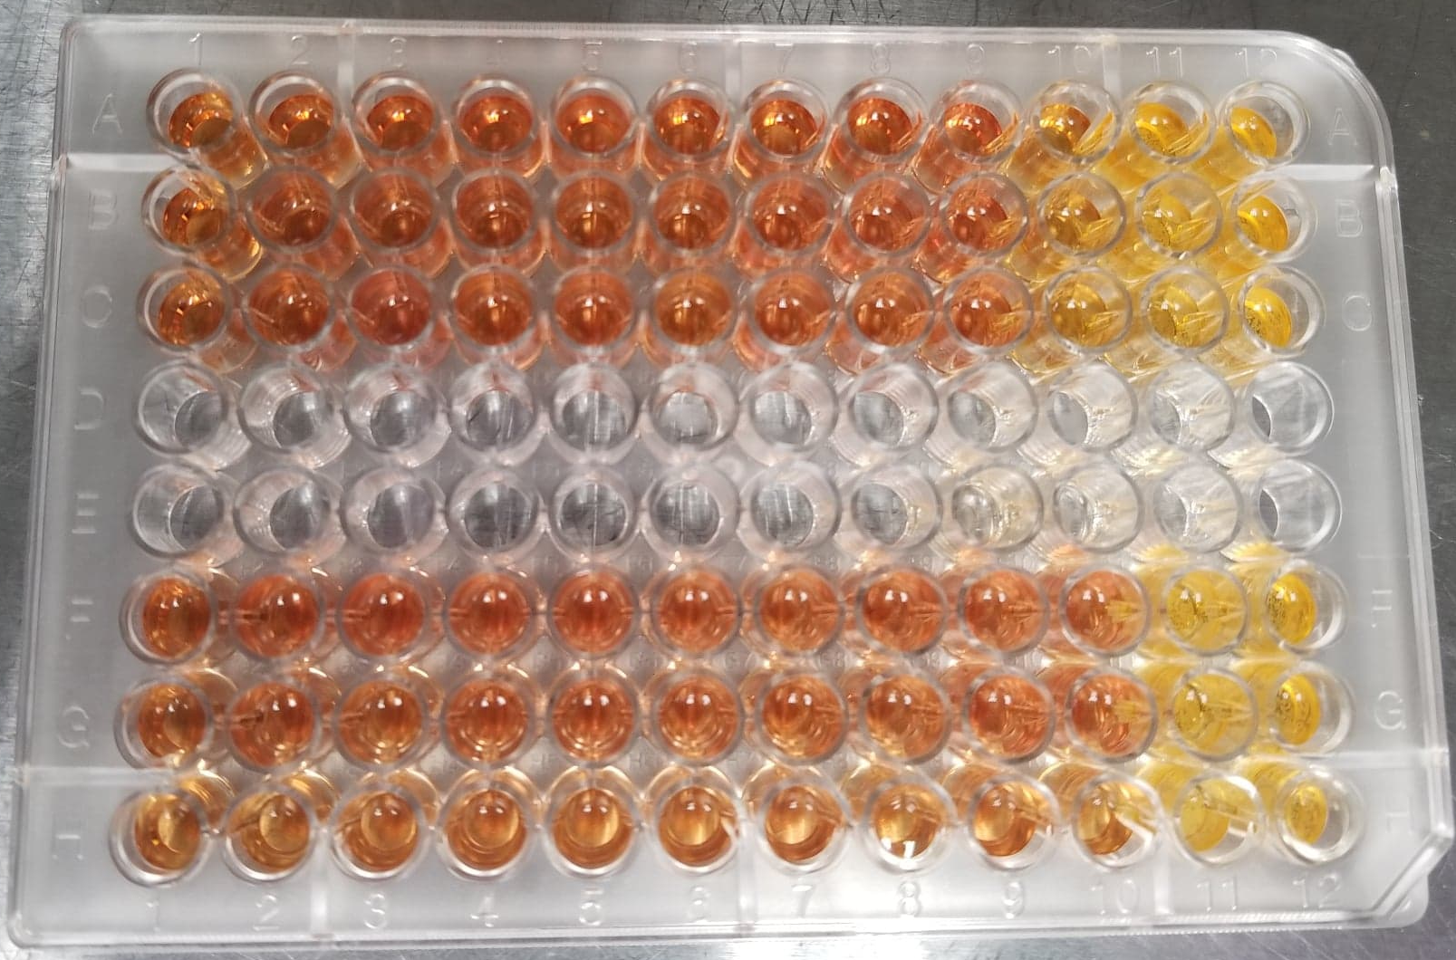
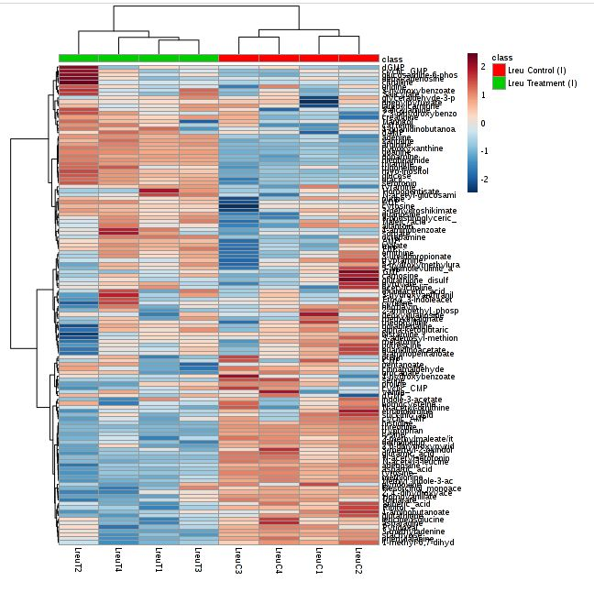
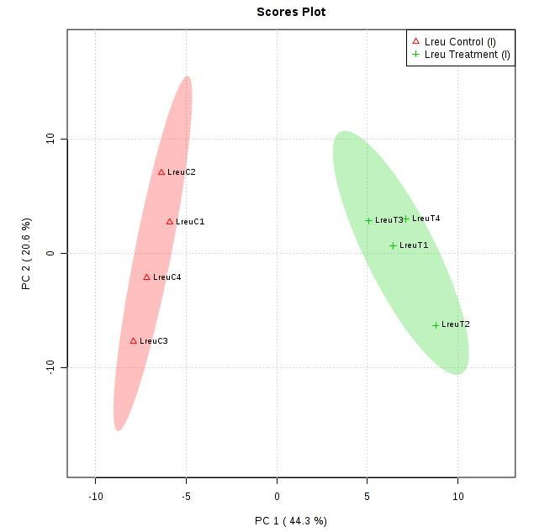
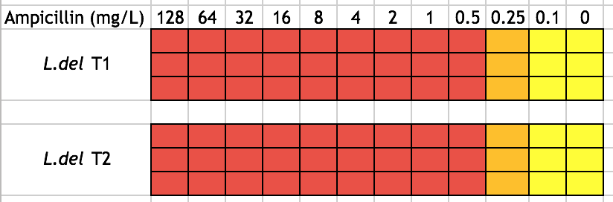
Investigating the effects of antibiotic perturbation on lactobacillus species metabolomics profiles
Sophia Lee¹, Kundi Yang², and Jiangjiang (Chris) Zhu²
¹Department of Chemistry and Biochemistry, Calvin College, Grand Rapids, Michigan 49546 and ²Department of Chemistry and Biochemistry, Miami University, Oxford, Ohio 45056
BACKGROUND
METHODS
Our gut microbiota contains a vast array of cells that influence human physiology, metabolism, nutrition and immune function. Lactobacillus is a group of Gram-positive, lactic acid bacteria that is naturally present in the human gastrointestinal tract. Some species are probiotics that provide beneficial health effects to humans. Many studies have investigated and noted their various health benefits to their human host, including prevention of certain diseases such as colon cancer, breaking down of food, and absorption of nutrients. Maintaining the balance of our normal flora is essential - even small perturbations to the microbiota can have significant health effects. It is important to understand how antibiotics could perturb probiotic strains, such as Lactobacillus, metabolically. Numerous factors such as temperature and pH cause stress on Lactobacillus bacteria, inducing phenotypical changes, the underlying mechanisms of which are still relatively unclear. Two different species, Lactobacillus delbruekii (L.delbruekii) and Lactobacillus reuteri (L.reuteri) were chosen for this research. L.reuteri is a naturally occurring gut bacteria while L.delbruekii is largely used in the fermentation of yogurt. Both species have been shown to provide various health benefits. Bacteria have been shown to undergo antibiotic-induced metabolome responses, which may contribute to bacterial susceptibility to antibiotics .
Simplified Workflow:
Figure 2. Optical Density (OD) measurements of L.delbruekii & L.reuteri control and ampicillin half MIC treatment groups after 15 hrs. Treatment groups were compared to the untreated control groups. (****) p-value<0.01. Both treatment groups from 07/06 showed a 40-50% decrease in OD from the control groups. 07/21 L.delbruekii treatment group showed a 20% decrease, and L.reuteri treatment group showed no significant difference.
A.
C.
RESULTS
B.
Figure 3. Heat map and principal analysis component (PCA) presentation of intracellular metabolic profiles. From 07/06, (A) is L.delbruekii, (B) is L.reuteri. (C) Metabolomics cloud plot from XCMS online that shows significantly up-regulated (green) and down-regulated (red) metabolites with p-value≤0.05 and fold change ≥1.5. From 07/21, top is L.delbruekii and bottom is L.reuteri.
CONCLUSIONS and FUTURE WORKS
https://www.intentio.com/wp-content/uploads/2016/10/Probiotics-768x517.jpg
Repeat to obtain consistent results, identify significantly changed metabolites, treatment with ampicillin & metabolite combination and observing changes in OD & metabolomics profiles.
GOALS
Figure 1. MIC results of ampicillin treated Lactobacillus. 100 µL of ampicillin solution from 256 to 0 mg/L, with 100 µL of 10⁴ to 10⁵ diluted bacterial culture, was added to each well (3 replicates for each concentration). 0.02% Resazurin dye used to observe color changes. Both L.delbruekii and L.reuteri had an MIC of 0.25 mg/L of ampicillin.
Determine minimum inhibitory concentration (MIC) using ampicillin for both strains
Treat bacteria with half MIC
Extract and analyze metabolite profiles using MetaboAnalyst and XCMS Online
ACKNOWLEDGEMENTS
This work was funded by Miami University, specifically Dr. Jiangjiang Zhu’s and Dr. Ann E. Hagerman’s lab, and the National Science Foundation Research Experience for Undergraduates program (award no. NSF CHM-1460862).

